Slide 1
Linguistics 201
Phonetics 4
Francisco Torreira
Notes:
Session ID: 410482Ma

Slide 2
Admin
Conference 1 this Friday
Registration open
Zoom links on myCourses soon
Quiz 1 available Wednesday from 5 pm
Phonetics unit
Open-book
Open for 24 hours
Completion time: 1h
If you need special access (i.e. OSD accommodations, registration issues), send me an email

Slide 3
Characterizing vowels
When describing vowels we specify:
height (opennesss)
backness
rounding
nasality (if not specified, assume oral)
length (if not specified, assume short)
Ex: [i] is a high front unrounded tense vowel
refers to position of tongue body
refers to position of lips

Slide 4
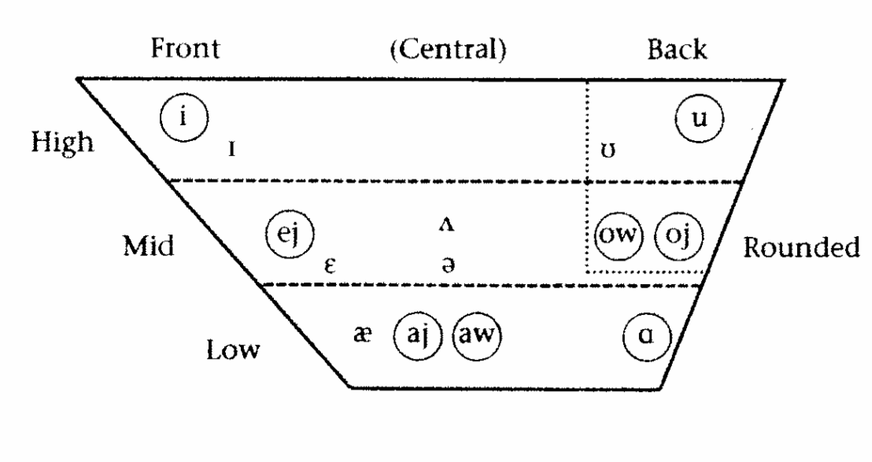
Canadian English vowels
Circles around tense vowels; you can ignore this distinction in this chapter
Notes:
Ej, ow, oj, aj, aw: diphthongs
Rest: monophthongs

Slide 5
Canadian English vowels
Front Vowels
/i/ as in ‘feel’
/ɪ/ as in ‘fit’
/ej/ as in ‘fate’
/ɛ/ as in ‘bet’
/æ/ as in ‘bat’

Slide 6
Canadian English vowels
Central Vowels
In this class, always use [ʌ] if stressed, schwa symbols if unstressed!
[ʌ] as in ‘hut’
[ə] as in ‘bacon’
[ɚ] as in ‘meter’
[ɝ] as in ‘purple’

Slide 7
Canadian English vowels
Back Vowels
If you distinguish the vowels in cot and caught, you can use [ɑ] and [ɔ]
/u/ as in ‘hoop’
/ʊ/ as in ‘book’
/ow/ as in ‘home’
/ɑ/ as in ‘father’
Notes:
Rounding:
In English, enhancing feature for back vowels
Rounding lips makes vocal tract longer > vowel sounds more back
In languages such as Turkish and French, lip rounding is plays a contrastive role in front vowels: Fr. dés / deux

Slide 8
Characterizing vowels
When describing vowels we specify:
Height (openness)
backness
rounding
nasality (if not specified, assume oral)
length (if not specified, assume short)
Ex: [i] is a high front unrounded tense vowel
refers to position of tongue body
refers to position of lips

Slide 9
Suprasegmentals
Phonetic and phonological phenomena that are ‘overlaid’ on segments (consonants & vowels) e.g.
Stress
Tone and intonation
Length
…

Slide 10
Syllable
Speech unit typically larger than a single sound and smaller than a word
Usually composed of no more than one vowel (i.e. the nucleus) and zero or more consonants
Syllable boundaries. We will study syllable structure in the phonology unit.
Notes:
Before stress, brief explanation of syllable

Slide 11
Stress
Some syllables in an utterance are more prominent than others
Such syllables are said to be stressed
In comparison with unstressed syllables, stressed vowels:
Tend to be louder
Tend to be longer
May display a pitch movement
Notes:
- Example with banana

Slide 12
Stress alternations in English

Slide 13
Stress alternations
present vs. to present
insult vs. to insult
overflow vs. to overflow
Notes:
Can you think of more stress minimal pairs?

Slide 14
Degrees of stress
Some words (usually long words) have more than one stressed syllable:
psycholinguistics /ˌsaj.kow.lɪŋ.ˈɡwɪs.tɪks/
magnification /ˌmæɡ.nɪ.fɪ.ˈkej.ʃən/
generation /ˌdʒɛ.nə.ˈrej.ʃən/
The supplementary reading marks stress in a different way.
We will follow the method discussed in class, not the one in the textbook!
Secondary stress
Primary stress

Slide 15
Tone
Tone languages use pitch to signal differences in word meaning
For this reason, linguists often refer to this phenomenon as lexical tone
Linguists often use L, M, and H letters to transcribe low, mid, and high level tones
e.g. Tsúut’ína level tones:
Notes:
Language from India

Slide 16
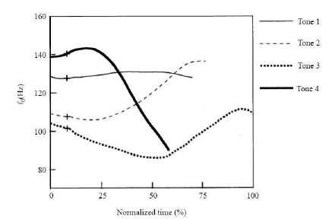
Tone
The tones of some languages appear to have complex shapes e.g. Tones 2, 3, and 4 in Mandarin:
Linguists refer to such tones as contour tones
From Xu (1997)

Slide 17

Tone
Contour tones can be represented using multiple level tones and association lines:
e.g. Mandarin tones:

Slide 18
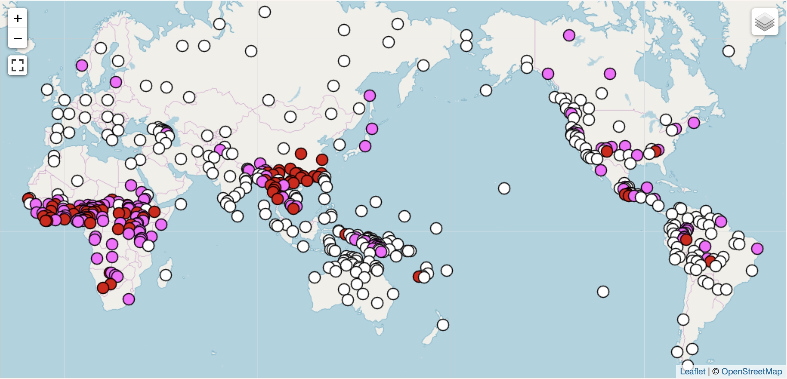
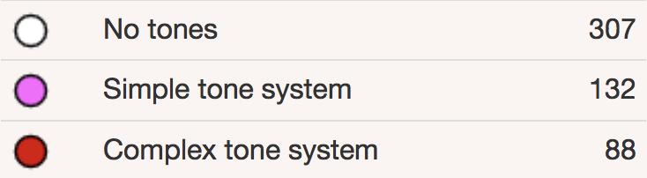
from World Atlas of Linguistic Structures
Notes:
43% of world’s languages are tonal!

Slide 19
Intonation
Intonation is the linguistic use of pitch contrasts to convey post-lexical meanings (i.e. meanings at the utterance level: statement vs. question, diff. kinds of statements)
Intonation contours can be analyzed as sequences of tones associated to specific points in an utterance

Slide 20
Intonation
Tones associated to stressed syllables are called pitch accents, and are often transcribed with a star: L*, H*
Tones associated with the edges of utterances are called boundary tones, and are often transcribed with a percent symbol: L%, H%
Intonation phrase defined by sequence of at least one pitch accent and one boundary tone

Slide 21

Falling tune
Fall from a final high accent H* to a low boundary tone L% at the end of intonational phrase:
Pitch (Hz)
[Legumes are a good source of vitamins]_{IP}
legumes are a good source of vitamins
H* H* L%
Ignore local pitch perturbations. They’re caused by consonants!
Notes:
- Change vitamins into

Slide 22
Low-rising tune
Pitch (Hz)
[Are legumes a good source of vitamines]_{IP}
are legumes a good source of VITAMINS
L* H%
Rise from final low accent to high boundary tone

Slide 23
Length
Many languages have vowels and consonants contrasts involving duration
Length is indicated in phonetic transcription by the use of a colon

Slide 24
Suprasegmentals
Phonetic and phonological phenomena that are ‘overlaid’ on segments e.g.
Stress
Tone and intonation
Length

